Slide 1


Using Reference Models for Service Mapping in Canadian Governments
GTEC 2008 Conference
October 28, 2008
Presenters:
Alain Perry
  Senior Project Coordinator, Enterprise Architecture and Standards, CIO Branch
  Service Mapping Subcommittee (SMSC), Federal co-chair
Roy Wiseman
  Chief Information Officer, Region of Peel
  Project Director, Municipal Reference Model Version 2 (MRM v2) Project
  for the Municipal Information Systems Association (MISA/ASIM)
  Service Mapping Subcommittee (SMSC), Municipal co-chair
John Chandler
  Senior Enterprise Architect, Service Alberta, Government of Alberta
  Service Mapping Subcommittee (SMSC), Provincial co-chair
Reference Models: a pan-Canadian Foundation for Government Improvement

Slide 2
Agenda
Part 1: What are reference models?
  What are reference models and why should you care?
Part 2: The Pan-Canadian Context
  What are different orders of government doing, both individually and collectively, to develop reference model standards, tools and capabilities that can be shared and leveraged by all governments in Canada?
Part 3: How can you use them?
  How can you use them in your program?
  How are they being used in other government jurisdictions?
Questions

Slide 3

Part 1: What are Reference Models?
Definition
An abstract representation of the entities and relationships involved in a problem space and forms the conceptual basis for the development of more concrete models of the space and, ultimately, implementations in a computing context.
It thereby serves as a… template for the development of more specific models …and allows for comparison between complying models.
Source: Wikipedia
In short:
A reference model is a set of rules for how you describe things.
Thanks. Now tell me why I care.

Slide 4
The challenge...
Simple Questions...
... Tough to Answer!
Why does our business exist?
How many programs and services do we provide?
Who do we work with? Who is accountable for what?
Are there duplicate services?
How much do we spend to deliver those services?
What has conflicting accountability? Or no accountability?
Are there services showing limited or no resources?
What is wrong with the way we are now? Where do we want to go? What are we changing to? What will it be like when we get there?
How will we know when we get there? How are we going to do it? Is it worth making the trip?
Tell me all the services any of our departments provide to a given target group (e.g. seniors, youth, aboriginals)?
Are the services achieving the desired program outcomes?
What about horizontal portfolios (departmental, intra- or inter- government)?
What investments best address seamless client-centred services?
Government is complex. Change is hard! Integrated change is even harder!!

Slide 5
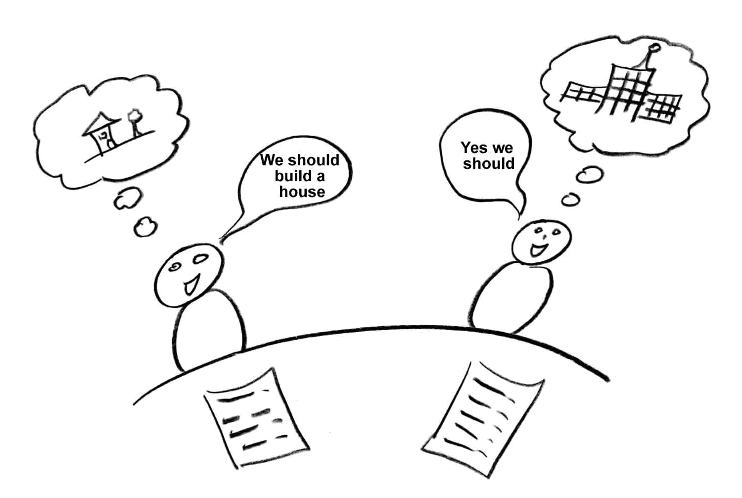
The challenge (cont’d)
Let’s build a house
Yes we should
Words (without rules for them) are weak. They can be misunderstood.

Slide 6
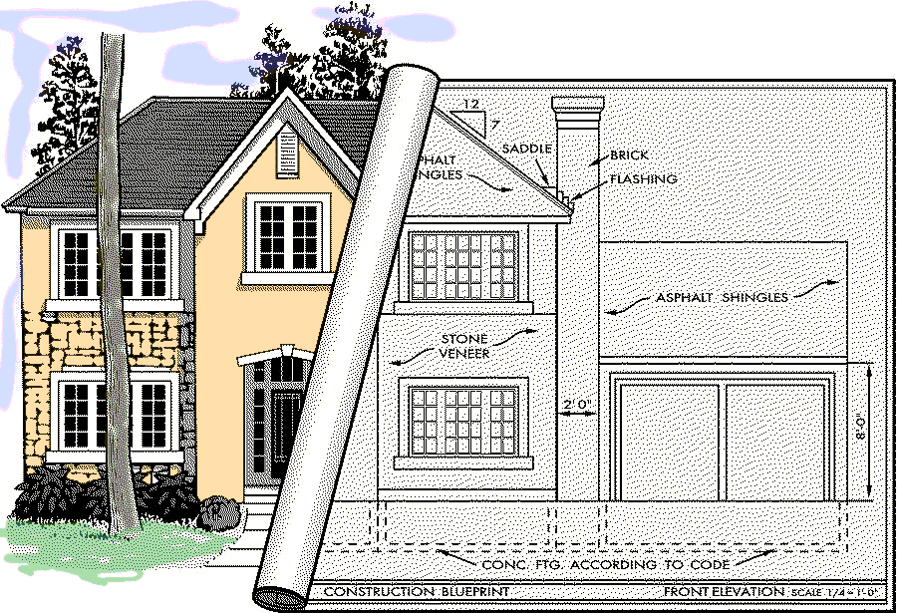
A Better Way
Let’s build a house
Yes we should
Creating superior results by design. By using a common, agreed-upon set of rules for creating better descriptions of what we want.

Slide 7

Coherent Government by design
If we really want:
  to move to a “whole of government” approach,
  seamless, citizen-centred services,
  legislation, regulations and policies designed rather than crafted,
  alignment, integration, interoperability, etc. in our business systems,
  to do more with less,
  etc.
We really need:
  a consistent and more formal business design capability based on a common language and set of rules for using it to create better descriptions of what we want (e.g. more coherent ones). A pan-Canadian standard along these lines will enable any conceivable government line-of-business (and inter-collaborations thereof) to better:
    interpret and clarify their missions, strategies, outcomes, etc.
    accurately depict or map how they work (and how they can work together),
    discover opportunities for business improvements,
    support their planning and successful implementation.
We really need:
a Canadian Governments Reference Model

Slide 8
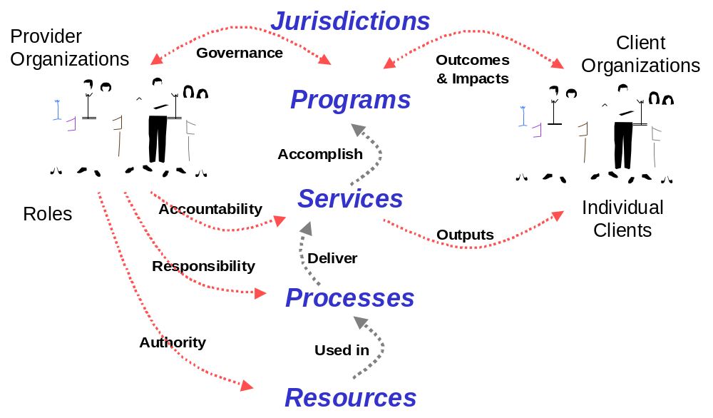
Government Reference Model Example
(source: the Government of Canada GSRM specification)
Government Reference Models Provide:
A Common Language and Structure for Describing and Improving Government.

Slide 9
Government Reference Model Example
(source: the Government of Canada GSRM specification)
Services
Clients
Outputs
The 19 GSRM Service Output Types
Supply capacity to act
  (Units of) Resource
  Funds
  New Knowledge
Enhance capability to act
  Care & Rehabilitation Encounters
  Educational & Training Encounters
  Movements
  Recreational & Cultural Encounters
Facilitate & influence action
  Advisory Encounters
  Advocacy and Promotional Encounters
  Matches, Referrals & Linkages
  Periods of Agreement
Regulation action
  Findings
  Interventions
  Penalties & Periods of Sanction
  Periods of Permission
  Periods of Protection
  Rulings & Judgments
Core
  Implemented changes
  Rules (laws, regulations, policies, strategies, plans, designs, standards)
Government Reference Models Provide:
Standard Classification Schemes ...and much more!

Slide 10

Part 2: The Pan-Canadian Context
  What are different orders of government doing, both individually and collectively, to develop reference model standards, tools and capabilities that can be shared and leveraged by all governments in Canada?

Slide 11

The Joint Councils
Public Sector Service Delivery Council (PSSDC)
Joint
Councils
Public Sector CIO Council (PSCIOC)
“We collaborate and share information
in areas of
common interest”
“We enable enhanced service
to the Canadian public through demonstrated leadership
in the management of
information and technology.”
“We share information, develop partnerships and facilitate potential solutions that can be used to improve public sector service delivery.”
Our members are:
Senior Service Delivery Officials
Our members are:
Chief Information Officers
A collaboration of all orders of government (Federal, Provincial/Territorial, Municipal)
along a continuum from knowledge sharing to pilot projects
Network of colleagues sharing knowledge
Common Tools
Shared Projects
Supported by the Institute for Citizen-Centred Service (ICCS)

Slide 12
Reference Models Across Canada
Looking Back: a 16-year proven history of enabling government.
1992-1998 Joint Venture / Chartwell Partnership
Municipal Reference Model (MRM)
1998... Ontario Enterprise Architecture Initiative
Public Service Reference Model (PSRM)
www.gov.on.ca/mgs/graphics/200067.pdf
2002... Federal Enterprise Architecture Initiative
Government of Canada Strategic Reference Model (GSRM)
www.tbs-sct.gc.ca/btep-pto
Next Steps: with the full support of the Joint Councils, two interrelated initiatives are
now underway to unify and build on the above and take it to the next level.
2007...
1. The Service Mapping Subcommittee (SMSC)
2. The MRM v2 Project
Canadian Governments Reference Model (CGRM)
Municipal Reference
Model Version 2 (MRMv2)
www.iccs-isac.org
www.misa-asim.ca/en/LatestNews.html

Slide 13
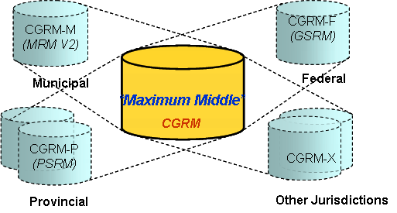
Initiative 1:
The Service Mapping Subcommittee (SMSC)
SMSC Goals:
  To establish the pan-Canadian standard Canadian Governments Reference Model (CGRM)
guiding principle:
the Maximum Middle

Slide 14
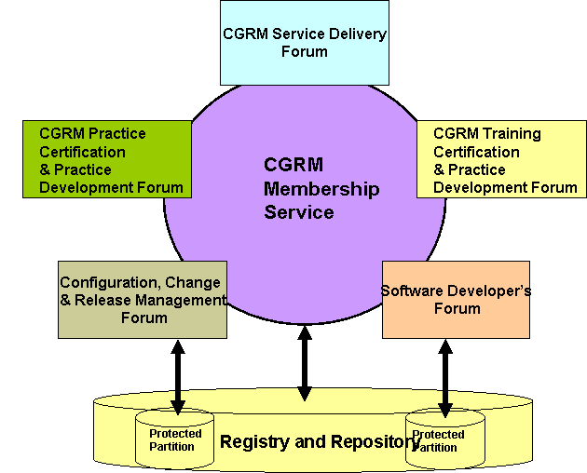
Initiative 1:
The Service Mapping Subcommittee (SMSC)
SMSC Goals:
  to establish the set of ongoing, financially-sustainable business services and computing infrastructure necessary to steward the CGRM and support its effective use and well-governed evolution over time.
concept of operations:

Slide 15
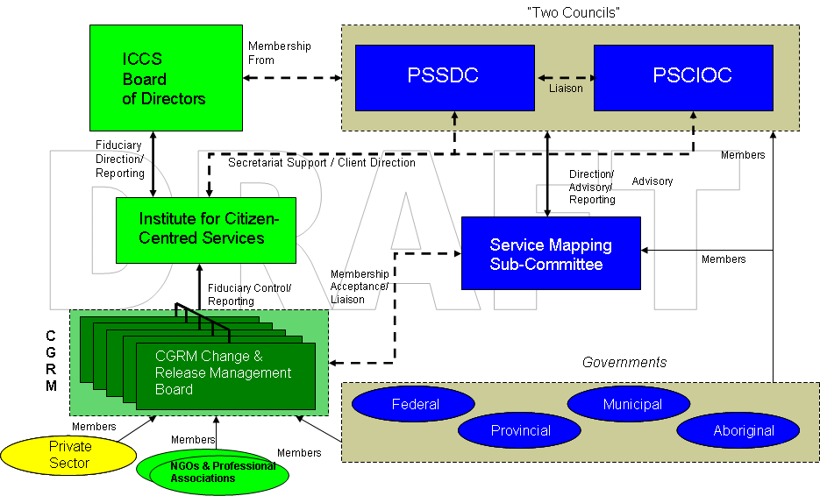
Initiative 1:
The Service Mapping Subcommittee (SMSC)
SMSC Program of Work:
Task 1: Develop a CGRM
Task 2: Develop Business Model (Business Proposal)
Task 3: Establish Memorandum of Understanding (MOU)
for the Institute of Citizen Centric Service (ICCS)
Task 4: Install a CGRM Governance Structure
Task 5: Recommend a Reference Model Infrastructure
(see draft structure below)
(that leverages and builds upon the work of the MRM v2 initiative)
Goal: sustainable, well-managed governance processes, stewarded by the ICCS, that allow the CGRM to evolve based on suggestions for improvement from both public and private sector stakeholders.

Slide 16
Initiative 2:
The Municipal Reference Model Version 2 (MRM v2)
MRM v2 Goal: to create a Tool (Product, Service) that will help municipal governments describe their vision, goals, objectives, programs, services, performance metrics, etc.
…in a standard way
…using precise definitions and concepts accepted and adopted by all governments in Canada
…with tools and templates to help you create the descriptions of the municipality
…with user guides and training material to help create and use these descriptions for a range of municipal purposes
…with a repository where these descriptions can be saved
…repository pre-populated with a generic set of service descriptions that may be provided by any municipality in Canada
…repository pre-populated with specific descriptions (models) created by other municipalities
…with tools that allow for the analysis and comparison of such descriptions
…and with a collaboration space that allows ideas to be shared on how these tools are being used in participating municipalities
In short:
A powerful Authoritative Service Catalogue that all Municipalities can use and share.

Slide 17
Initiative 2:
The Municipal Reference Model Version 2 (MRM v2)
MRM v2 Components:
MRM Reference Model
(i.e. Public Safety Program, Fire Rescue Service, etc.)
Customized “My Municipality’s” Model
MRM Meta-Model
(i.e. Shell Program, Shell Service, etc.)
Customized Halton Model
Best Practice Model
(i.e. AWWA Potable Water Supply Service, etc.)
Customized York Model
Customized Peel Model
(i.e. Peel Potable Water Supply Service)

Slide 18
Part 3: How Can You Use Them?
  How can you use them in your program?
  How are they being used in other government jurisdictions?

Slide 19
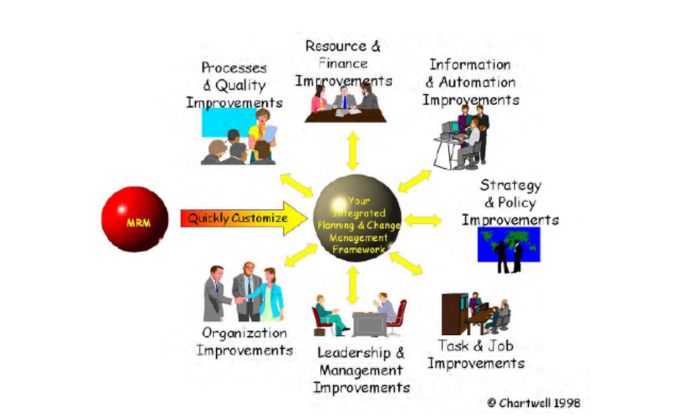
Q: What Can You use Them For?
A: Anything! (anything that needs describing)
Strategy and Policy Improvements
Process and Quality Improvements
Organizational Improvements
Leadership and Management Improvements
Human Resource Management Improvements
Financial Management improvements
Information and Technology
Improvements
etc.

Slide 20
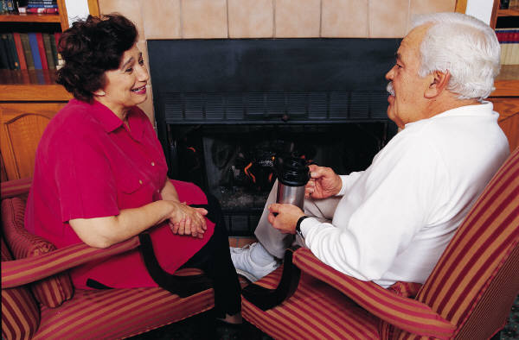
Seniors Service Mapping Initiative
Participants:
  Veterans Affairs Canada,
  Canada Revenue Agency,
  Social Development Canada,
  Health Canada,
  Ontario Ministry of Health and Long-term Care,
  Ontario Ministry of Consumer and Business Services,
  Ontario Seniors Secretariat,
  Representatives from Niagara Community Services,
  Public Health and Police departments
Methodology
  16 people participated in three two-day sessions to identify potential transformation opportunities
Output:
  a shared vision for Seniors across all jurisdictions
  a standardized definition of seniors’ programs
  a problem statement based on ranking and rigorous root cause analysis opportunities for transformation, ranked and profiled, with initial business cases

Slide 21
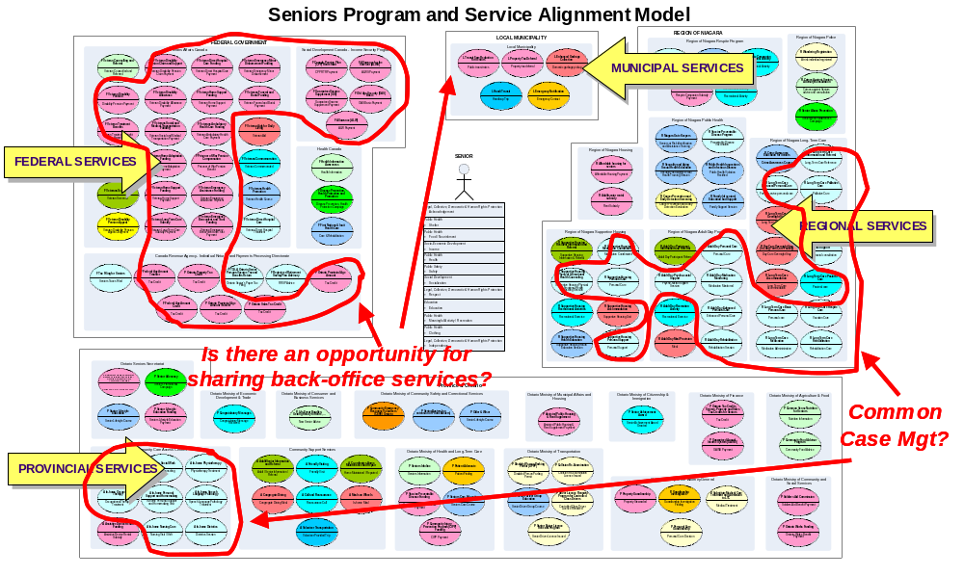
Opportunities for Working Vertically and Horizontally in Seniors Programs

Slide 22
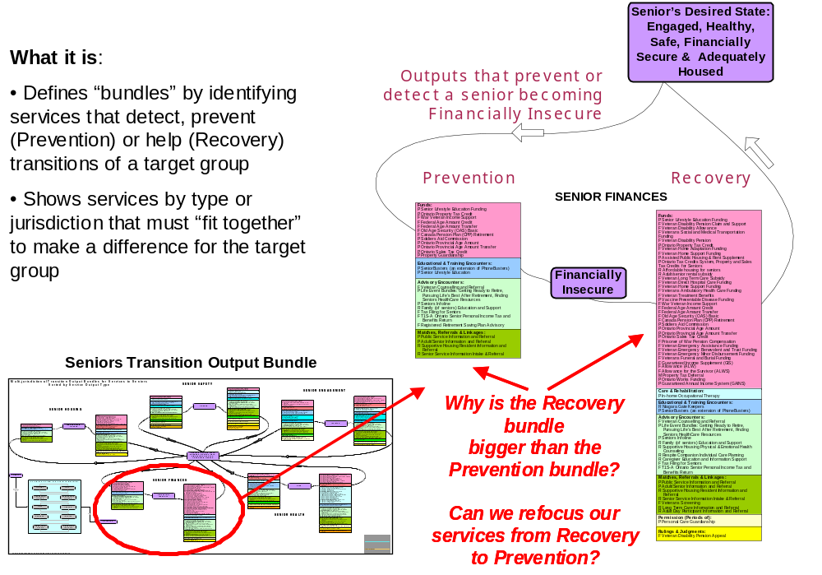
Service Improvement Opportunities

Slide 23

Integrated Water Management Architecture
Approved by the Ontario Water Directors’ Committee in Feb 2001
Participants
  Ministry of Environment
  Ministry of Natural Resources
  Ministry of Agriculture & Food
Methodology
  Approach focused on public target groups and water related needs rather than administrative function
Outputs
  a contextual view of water management in Ontario
  100+ provincial services identified within 19 Programs

Slide 24
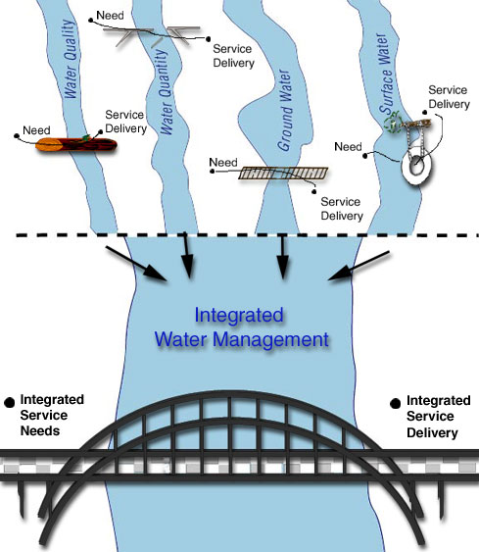
The Integrated Water Management Architecture Vision
“As is”
“To be”
Integrated Solutions
Integrated
Service
Needs
Integrated
Service
Delivery
Business/ I&IT Strategy
Planning
Program Mgmt
Architecture

Slide 25
One Toolkit, Many Uses
Application
Budget/Service Review
Organizational Design
Corporate Strategic Plan
Technology Plan
Application Design
Process Improvement
Amalgamation Planning
Certification (ISO, NQI)
Benchmarking
Sample Municipalities
Brantford, Coquitlam, Guelph, Winnipeg
Fredericton, Halifax, Saint John
Milton, Saint John, Centre Wellington
Brantford, Guelph, Phoenix
Peel, Phoenix, Shanghai
Peel, Polish municipalities
Guelph, Halifax, Toronto
Fredericton, Saint John
Ontario Municipal Benchmarking Initiative (OMBI)

Slide 26


Questions

